Slide 1
Blockchain Diary
Decentralized Social Media App running on Nebulas Mainnet

Slide 2
What is Blockchain Diary?
It’s a highly secure decentralized social networking app (DAPP) running on Nebulas Mainnet where you can:
Share your posts directly on Blockchain.
Search for and follow other users to get their latest updates on your timeline/feed.
Comment on your as well as other users’ posts.
Receive notifications about other users following you, commenting on your posts etc.
View your user profile settings and change them when you want.

Slide 3
First things First!!
Blockchain Diary is optimized only for Chrome browser at this point.
In order to use this DAPP, you’ll have to download Nebulas chrome extension from this location
https://chrome.google.com/webstore/detail/nasextwallet/gehjkhmhclgnkkhpfamakecfgakkfkco

Slide 4
Strong resistance to hacking:
Please store your NAS Mainnet Wallet keystore file in a secure location. It’ll always be needed when you try to call the smart contract.
All the calls to the smart contract through this DAPP will look for the wallet address with which you signed up for Blockchain Diary. If it doesn’t match, calls to the smart contract will throw an error.
So, even if a hacker gets access to your username and password, they can’t even login since they won’t have your NAS wallet keystore file and the password to unlock it.
You can change your wallet address by going to your profile settings which is described later.

Slide 5
Technical approach to handle smart contract calls:
State changes in Angular are initiated only when smart contract calls are successful. Example below:
executeTxn = $interval(function() {
neb.api.getTransactionReceipt({hash: txnHash}).then(function(receipt) {
});
}, 3000);
Transaction hash is queried against getTransactionReceipt() of Nebpay API every 3 seconds(so that state change can be initiated as soon as possible) and only if receipt.status==1(meaning post was successful), state transition will be initiated. If receipt.status==0(failure), error message will be displayed on the screen.

Slide 6
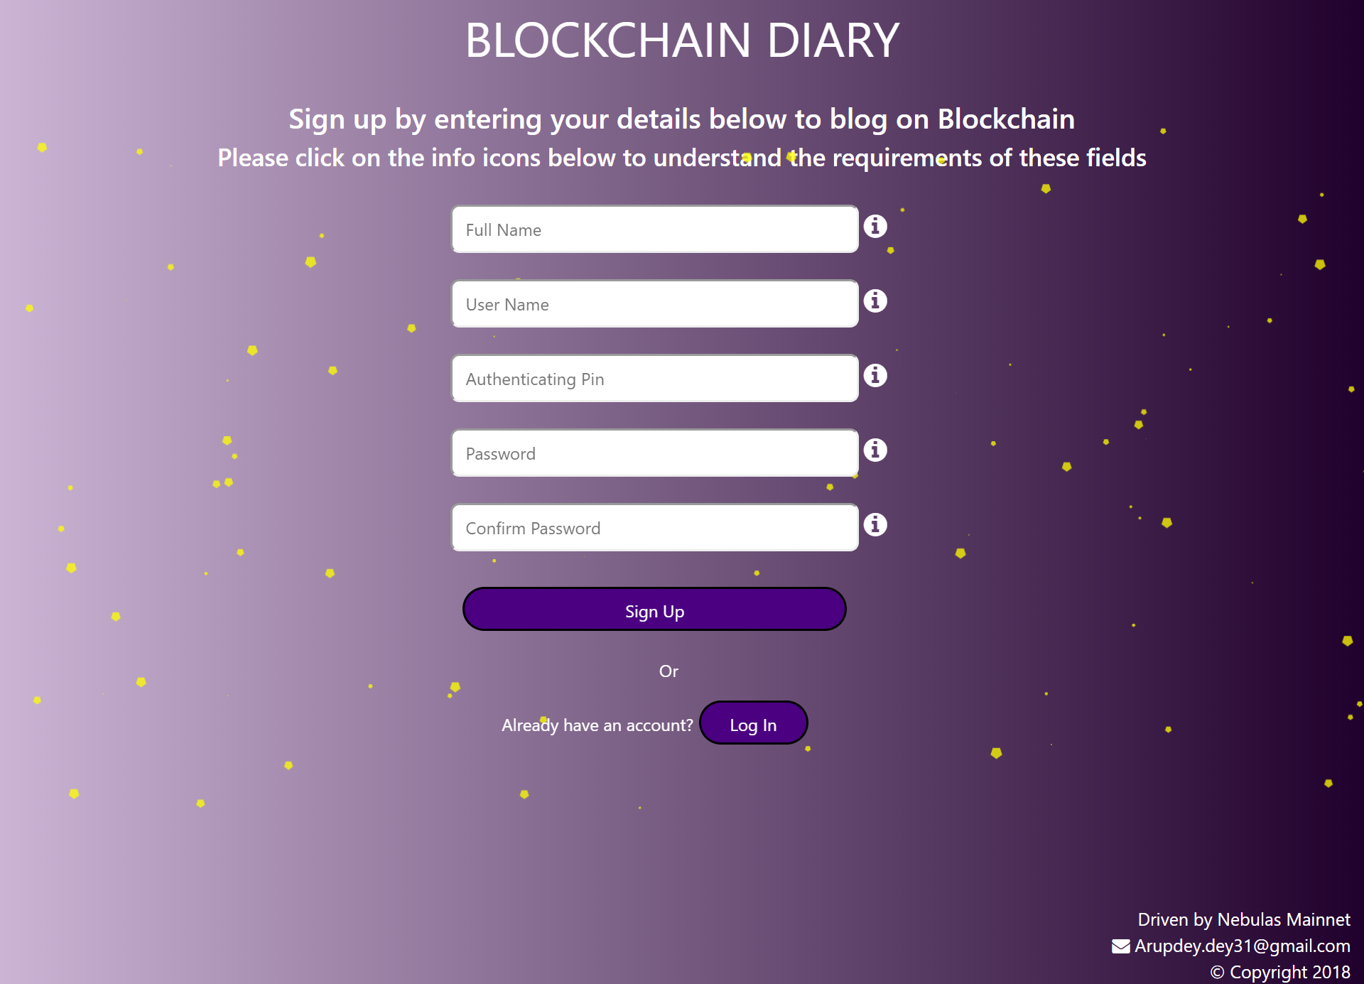
Register your account:

Slide 7
Register Account Contd.
As you can see in the previous screen, you’ll have to provide some information in order to sign up for Blockchain Diary
Full Name -> Your full name
Username -> This has to be unique and will be needed for login. When you click on sign up, it will search this username against the list of existing usernames and if it already exists, it will throw an error saying that username already exists.
Authenticating Pin -> This is very important and should be stored safely. It’ll allow you access for changing your settings.
Password -> This will be needed every time you login to the dapp.
There are inline validations for all the fields e.g., none of the fields can be left empty, username has to be more than 3 characters etc. The requirements can be seen by clicking the info icons. Same validation is done from the smart contract as well so if someone tries to modify DOM and override UI validation, smart contract will block those.

Slide 8
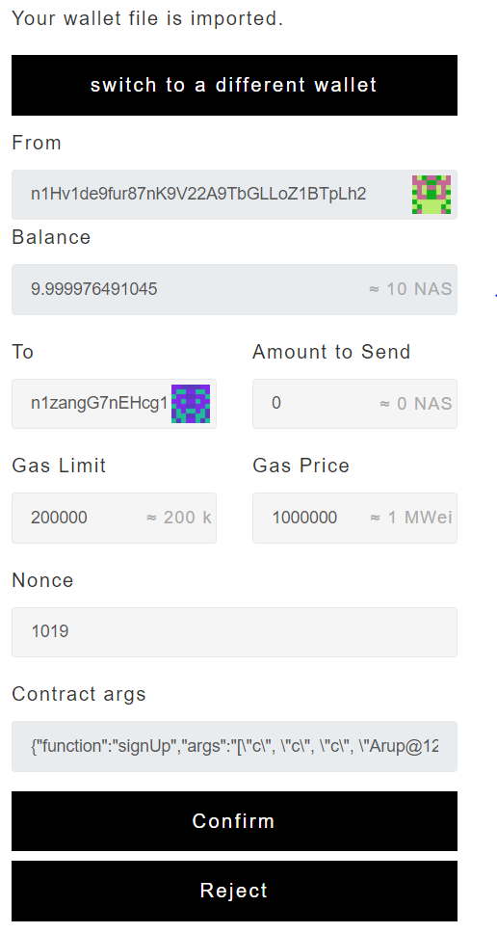
Register Account Contd.
Once you enter all the information and click on sign up, you will be presented with the following window from the NAS extension you previously downloaded:
All you have to do is import your NAS wallet
and enter your wallet password and click on confirm.

Slide 9
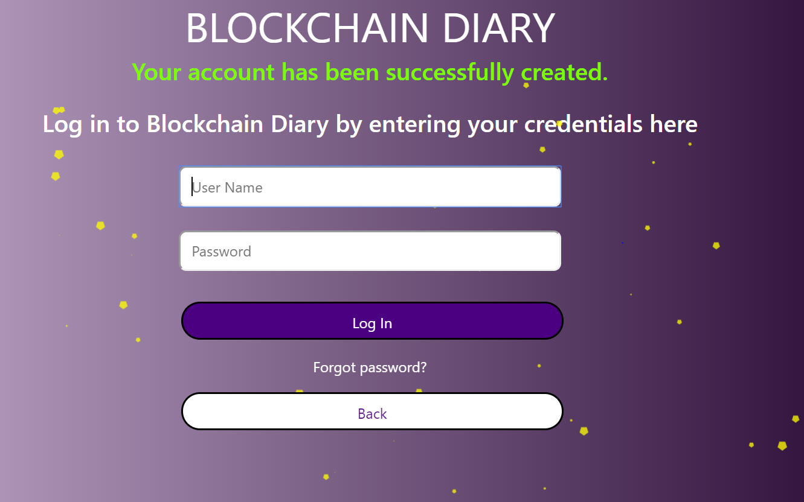
Log In
If your sign up is successful, you will be presented with the following screen:
You can now login using your username and password.
The forgot password link is not live yet but it’s being worked on.

Slide 10
Home Page of the DAPP:

Slide 11
Home Page Contd.
When you click on find users on the home page, it’ll return all the users that have registered to Blockchain Diary.

Slide 12
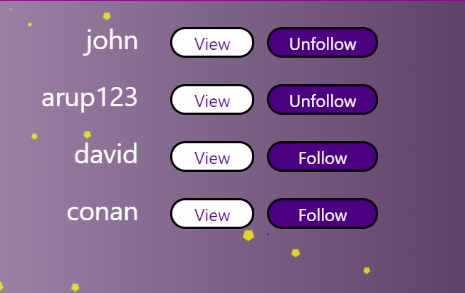
Home Page contd.
You can either view the user profiles or follow them.
Once you follow the users, the button names will be changed to unfollow.

Slide 13
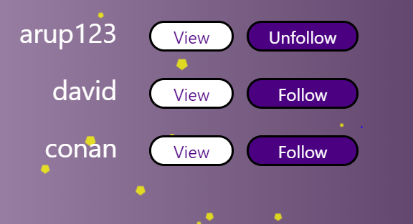
List of other activities:
1. Search on the top left: You can search for all the users that have registered for Blockchain Diary. If you do a blank search, all the users will be returned. If you search for a text, it’ll search for users whose usernames contain that text.
Here’s a screenshot:
As you can see, you can view the user profiles or follow/unfollow them.
I typed “a” and clicked on search and it returned all the users that have usernames containing the letter, “a”.

Slide 14
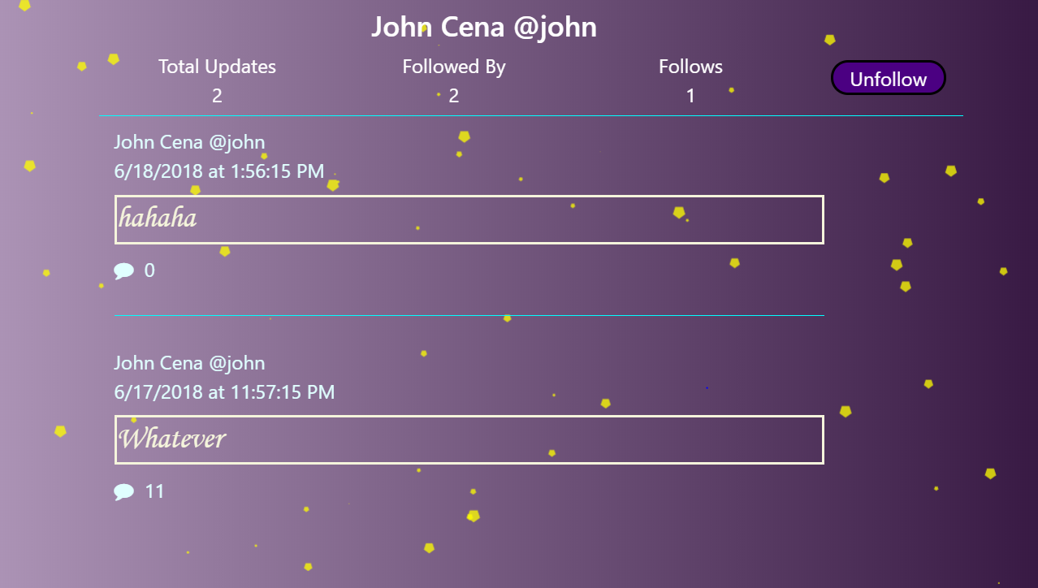
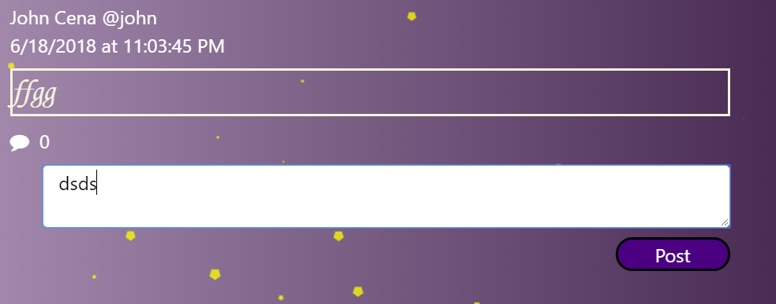
View User
2. View User: If you clicked on view, you will be taken to user profile where you can comment on their posts and see the number of people that follow them.
You will also have the option to follow/unfollow them here.
You can click on the comment icon to read all the comments associated with a post as well as comment on the blog. Once you start typing, a post button will appear. When you click on post, the window from extension will appear and you’ll have to confirm to post your comment.

Slide 15
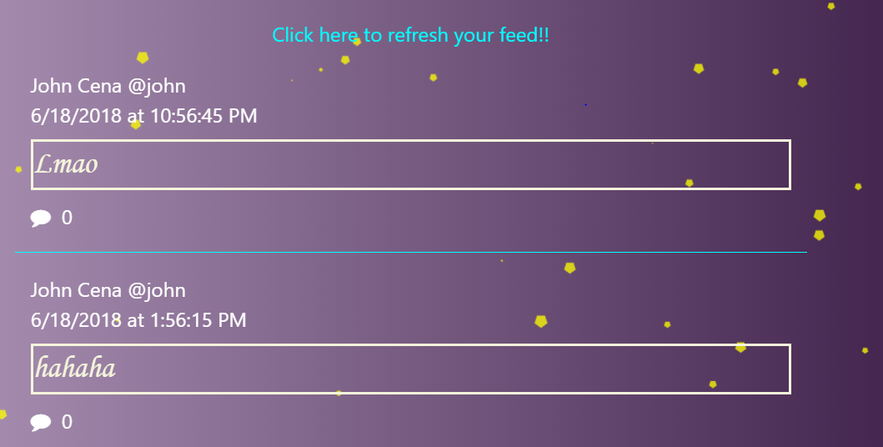
List of activities contd.
Once you follow users, their posts will be shown on your feed and you can comment on those directly from your timeline.
When you’re reading through the posts on your timeline, every 60 seconds, the dapp looks for new updates that your followed list of users might make and if there’s any new update, you will see the following screen:
You can click on refresh your feed and your timeline will be updated.

Slide 16
List of activities contd.
3. Notifications: When you click on notifications, it’ll return list all the notifications that you have received. Example below:
These notifications are clickable.
If a follow notification gets clicked, it will take you to that user’s profile.
If a comment notification is clicked, it will take you to your own profile.

Slide 17
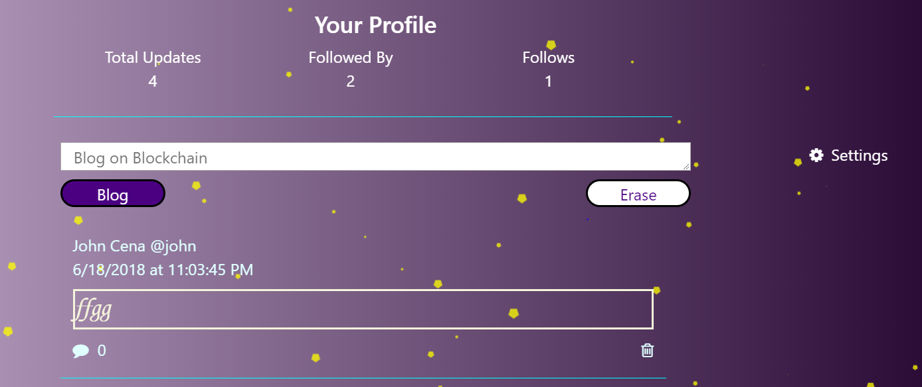
List of activities contd.
You can click on Profile and see all the posts that you have shared so far.
You also have the option to delete them.
You can also comment on your own post.

Slide 18
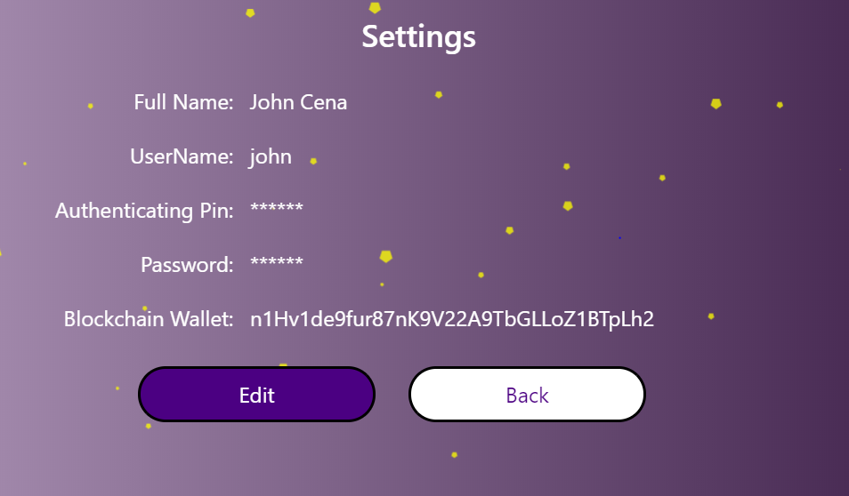
List of activities contd.
If you click on settings, it’ll take you to a read only page for your account settings:

Slide 19
List of activities contd.
You can click on edit to edit your settings and you’ll be prompted to this screen:

Slide 20
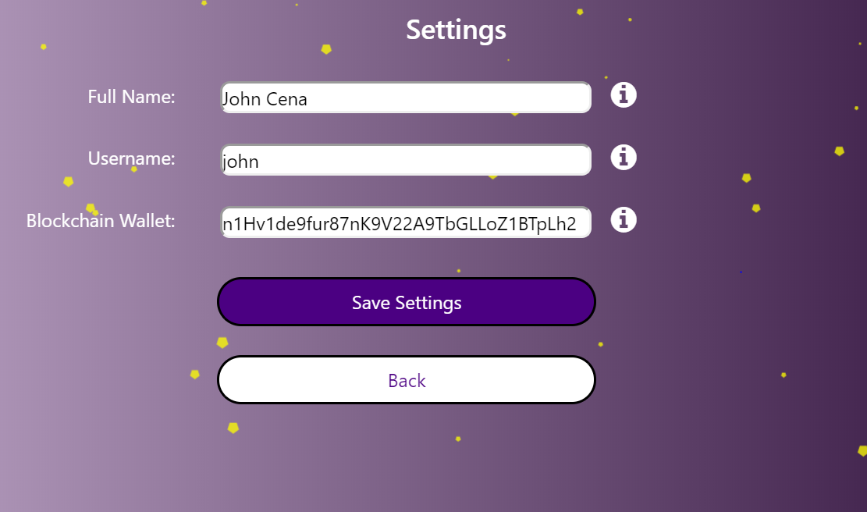
List of activities contd.
You can enter your credentials and if authenticated properly, you’ll be taken to this screen:
Here, you can edit your full name, username and your blockchainwallet address.
If you change your username, your previous username will be available if someone else wants it.
While saving your settings, it will check if there’s an existing user with the same username. If that username exists, it will throw an error.
There are inline and smart contract validation also for the values you enter here. Info icons describe the requirements of these fields.

Slide 21
Save Settings contd.
If you update your username and fullname by clicking on save settings, all your posts will be updated with your updated username and fullname. Example below:
Before:
After:

Slide 22
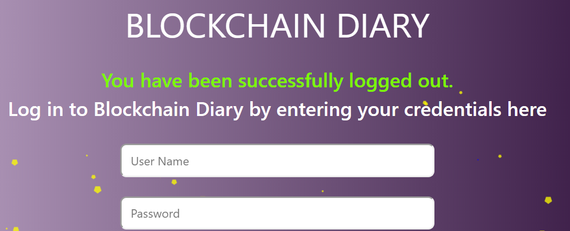
List of activities contd.
Clicking on logout will log you out of this Dapp.

Slide 23
To be worked:
Forgot Password Link: On click, user will be presented with a screen asking for username and authenticating pin. If the credentials are authenticated, they will be allowed to change password. Of course, the blockchain wallet address has to be the same as the one stored on file. It can be checked by going to settings page.
Search functionality will not only allow search for username but also searching for posts. So, if someone searches for ‘crypto’, all the posts that have crypto written on them will be returned.
Messaging between users will be enabled.
If a user really appreciates a post shared by someone and wants to pay them, they will be able to do so by transferring NAS.
Sharing posts will be enabled.
Comments will be allowed to delete.
List of followers and people you follow will be displayed on clicking those links in profile page.
DAPP will be made mobile friendly.

Slide 24
To be worked contd.
Currently, because of less number of users, timeline will contain all the updates made from them irrespective of date. But, it will be changed to include only the latest updates from the followed users.

Slide 25
Thank you
Arup Dey
Arupdey.dey31@gmail.com
Copyright 2018

